Slide 1
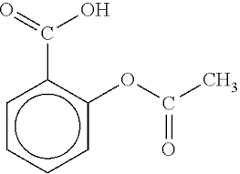
Aspirin

Slide 2
Aspirin
is the common name for the compound acetylsalicylic acid.
is the used as anti-inflammatory, analgesic, antipyretic, and antiplatelet.

Slide 3
Synthesis of aspirin
Salicylic acid is reacted with an excess of acetic anhydride. A small amount of a strong acid is used as a catalyst which speeds up the reaction(esterification of salicylic acid).

Slide 4
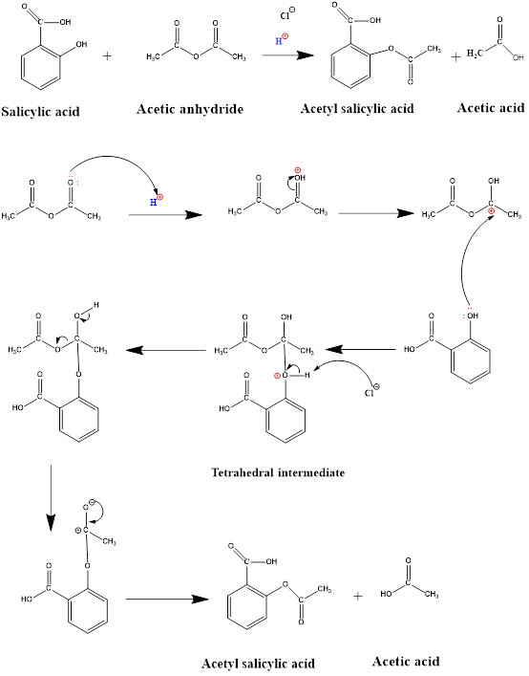

Slide 5
(Nucleophilic substitution at the carbonyl group)

Slide 6
Procedure
1. Place 0.5 grams of salicylic acid into a beaker along with 3 mL of acetic anhydride and 5 drops of conc Hcl.
2. Heat the mixture for 10 minutes with stirring.
3. Cool the mixture by adding ice cubes with stirring. Crystals of aspirin started to form as the mixture cooled.
4. Filter the mixture and wash the crystals with cold distilled water.
5. Purification of Aspirin by recrystallization: dissolve the crude aspirin crystals in a minimum amount of hot distilled water. Then filter the solution and cool it to get the aspirin crystals again, and finally filter it.
6. Calculate % yield.

Slide 7
Calculation
Moles (Salicylic acid) = Moles (Aspirin)
Wt / M.Wt (Salicylic acid) = Wt / M.Wt (Aspirin)
O.5 g /138.12 g mol-1 = Theoretical Wt / 180.16 g mol-1
% yield = Practical Wt / Theoretical Wt

Slide 8
Moles (Salicylic acid) = Moles (Acetic anhydride)
Wt / M.Wt (Salicylic acid) = Wt / M.Wt (Acetic anhydride)
0.5 g / 138.12 g mol-1 = Wt(Acetic anhydride) / 102.09 g mol-1
D = Wt / V
1.08 g mL-1 = Wt / V?

